Slide 1
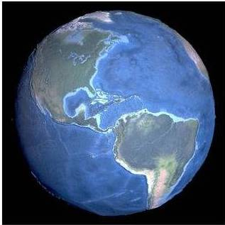
Monthly Meeting
January 24, 2024
Central Maryland Chapter Sponsors:
Convergint Federal, Gtegrity, Inc., Maryland Innovation Center

Slide 2
Board of Directors
Bill Smith, Jr., CISSP, GSNA, CEH, GPEN, GCFA, GCFE - President
Sidney Spunt, CISSP - VP Operations
Lorenzo Thweatt, CISSP - Secretary
Bill Zook, VP Outreach
Kevin Newman, CISSP – VP Education
Seth Wilson, MBA, CISA, CISSP – Treasurer
Stephan Chan, CISSP, PMP – VP Membership
Phil Rogofsky, CPA, CISSP - VP Professional Development
Central Maryland Chapter Sponsors:
Convergint Federal, Gtegrity, Inc., Maryland Innovation Center

Slide 3
Central Maryland Chapter Sponsors
Central Maryland Chapter Sponsors:
Convergint Federal, Gtegrity, Inc., Maryland Innovation Center

Slide 4
New Central Maryland Chapter Sponsor
CYBERSECURITY ENGINEERING SOLUTIONS
Consulting & Support Services
Gtegrity is an innovative provider of Information Assurance (IA), Information Technology (IT) and Cybersecurity solutions to Federal, State and commercial clients. Gtegrity specializes in the integration of Corporate owned or leased environments with Department of Defense (DoD), Intelligence Community (IC) or Government accredited secure facilities (SCIFs, Closed and Restricted Space).
https://gtegrity.com
Central Maryland Chapter Sponsors:
Convergint Federal, Gtegrity, Inc., Maryland Innovation Center

Slide 5
New ISSA International Management
Jennifer Hunt: Executive Director
Central Maryland Chapter Sponsors:
Convergint Federal, Gtegrity, Inc., Maryland Innovation Center

Slide 6
ISSA Central MD Non-Member Policy
The Board of Directors is making changes to the policy for non-members attendance beginning 1st Quarter 2024
ISSA Central MD Membership Meetings.
$10.00 non-members (in-person or remote)
Pay on-line at time of registration or at the door
More details to come!
On-Hold
Central Maryland Chapter Sponsors:
Convergint Federal, Gtegrity, Inc., Maryland Innovation Center

Slide 7
Meeting Location:
New location: ?????
New Times: ?????
Central Maryland Chapter Sponsors:
Convergint Federal, Gtegrity, Inc., Maryland Innovation Center

Slide 8
Certification Continuing Education Units
Responsibility of each member to submit their CEUs
Certificate of Attendance available upon request
Central Maryland Chapter Sponsors:
Convergint Federal, Gtegrity, Inc., Maryland Innovation Center

Slide 9
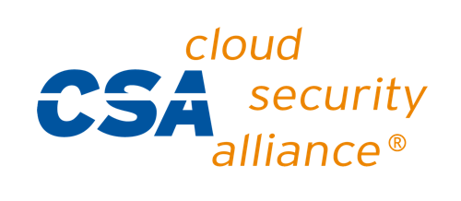
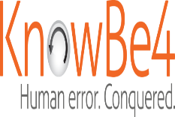
ISSA Member Benefits
List of special offers available to members. You will need to login with your member portal credentials to access this page.
https://www.members.issa.org/page/SpecialOffers
Central Maryland Chapter Sponsors:
Convergint Federal, Gtegrity, Inc., Maryland Innovation Center

Slide 10
ISSA Special Interest Groups https://www.members.issa.org/general/custom.asp?page=ISSASpecialInterestGroups
ISSA has many opportunities for members to form and participate in global initiatives and working groups. As a member, you can choose to be active in one or more of these Special Interest Groups (SIG).
Women in Security Special Interest Groups
Mission: Develop global women leaders and build a stronger community to create a compelling environment around cybersecurity and technology.
Privacy Special Interest Group (SIG)
This group is dedicated to providing privacy relevant topics to security professionals through thought leadership and a knowledge-sharing platform. The Privacy SIG will be hosting quarterly webinars and providing concise and timely privacy-related information. Cyber Resilience Special Interest Group (SIG)
Mission: Build a global community of Cyber Resilience professionals in order to share actionable best practices to protect our organizations from cyber-attacks on high value assets.
Central Maryland Chapter Sponsors:
Convergint Federal, Gtegrity, Inc., Maryland Innovation Center

Slide 11
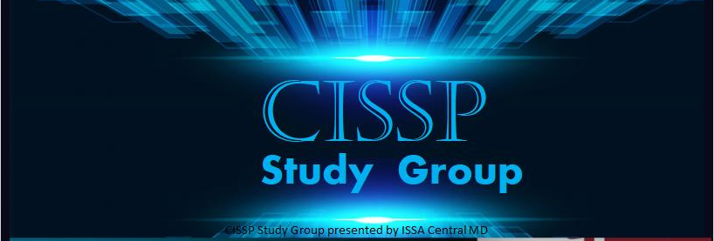
Convergint Federal | 6650 Eli Whitney Dr | Suite 105 | Columbia, MD 21046
Tuesday, February 20, 2024 - Tuesday, May 21, 2024 at 5:00 PM - 8:00 PM (EST)
Gain credibility as a security expert.
Become a more marketable/hirable candidate.
Become/remain contractually compliant (DoD 8570.01 Manual / DoDD 8140)
Improve IT security skills and enhancing productivity.
Relaxed pace – rather than the “fire hose” effect, offered one night a week over 14 weeks.
Offered in your local area/virtually. No travel, lodging costs, or time lost from work/family.
Meals are included each night for in-person sessions*
Cost: just $450 (+ EventBrite Fees –> approximately $29.02)
Sponsors:
Central Maryland Chapter Sponsors:
Convergint Federal, Gtegrity, Inc., Maryland Innovation Center

Slide 12
Free Security Training
Fortinet - Advanced training for security professionals, Technical training for IT professionals, and Awareness training for teleworkers: https://www.fortinet.com/training/cybersecurity-professionals.html
Cambridge - Software and Security Engineering: https://www.cl.cam.ac.uk/teaching/1920/SWSecEng/materials.html
Palo Alto Network - Free Cybersecurity Education for ALL: https://www.linkedin.com/pulse/free-cybersecurity-education-all-florian-buijs/
6 Free Cybersecurity Training and Awareness Courses: https://www.darkreading.com/threat-intelligence/6-free-cybersecurity-training-and-awareness-courses/d/d-id/1337781
Cybrary Makes 500+ Hours of Premium Training Content Free to Address Cybersecurity Skills Shortage: https://www.cybrary.it/blog/500-hours-free-content-to-address-cybersecurity-skills-shortage/
Central Maryland Chapter Sponsors:
Convergint Federal, Gtegrity, Inc., Maryland Innovation Center

Slide 13
FREE Cyber Security Certifications/Training
1. Introduction to Cybersecurity
2. Cybersecurity Essentials
3. Networking Essentials
4. Intro to Information Security
5. Network Security
6. NSE 1,2 & 3
7. Information Security
8. Network Security
9. Risk Management
10. Certified in Cybersecurity
11. CCNA Security Courses
12. Network Defense Essentials (NDE)
13. Ethical Hacking Essentials (EHE)
14. Digital Forensics Essentials (DFE)
15. Dark Web, Anonymity, and Cryptocurrency
16. Digital Forensics by Open Learn
17. AWS Cloud Certifications (Cybersecurity)
18. Microsoft Learn for Azure
19. Google Cloud Training
20. Android Bug Bounty Hunting: Hunt Like a Rat
21. Vulnerability Management
22. Software Security
23. Developing Secure Software
24. PortSwigger Web Hacking
25. RedTeaming
26. Splunk
27. Secure Software Development
28. Maryland Software Security
29. Cyber Threat Intelligience
Central Maryland Chapter Sponsors:
Convergint Federal, Gtegrity, Inc., Maryland Innovation Center

Slide 14
https://github.com/cloudcommunity/Free-Certifications?utm_source=tldrnewsletter
Central Maryland Chapter Sponsors:
Convergint Federal, Gtegrity, Inc., Maryland Innovation Center

Slide 15
Upcoming Summits
Summit & Training events provide an immersive training experience that arms attendees with deep-knowledge and actionable information and has a lasting impact on their careers and their organization’s security programs. https://www.sans.org/cyber-security-summit
Event | Location | Dates
Cyber Threat Intelligence Summit & Training 2024 | Washington, DC & Virtual | Summit: Jan 29-30 Training: Jan 31 - Feb 5
OSINT Summit & Training 2024 | Arlington, VA & Virtual | Summit: Feb 29 - Mar1 Training: Mar 2-7
New2Cyber Summit & Training | Virtual | Summit: April 4 Training: April 8-13
Cybersecurity Leadership Summit | Virtual | Summit: Thursday, May 16
Ransomware Summit | Virtual | Summit: Friday, May 31
ICS Security Summit & Training | Orlando, Fl & Virtual | Day 0: June 16 Summit: June 17-18 Training: June 19-24
Neurodiversity in Cybersecurity Summit | Virtual | Summit: Thursday, June 27
SSA Managing Human Risk Summit 2024 | Norfolk, VA & Virtual | Summit: Jul 29-Aug 7
Central Maryland Chapter Sponsors:
Convergint Federal, Gtegrity, Inc., Maryland Innovation Center

Slide 16
ISSA Central MD 2023 Meetings and Events
Date | Speaker | Organization | Topic
January 24, 2024 | Danielle Spencer |  | Privacy and The Rule of Law In The Digital Age
February 28, 2024 | Nik Pruthi | NikSun | Cybersecurity, Compliance and Network Infrastructure Operations - Redefined
March 27, 2027 | Amy Hamilton
April 24, 2024
May 22, 2024 | Phillip Payne | Cybersecurity & Information Systems Information Analysis Centers (CSIAC) | Jumpstarting your Research with the DoD Cybersecurity & Information Systems Information Analysis Centers (CSIAC)
June 26, 2024
Central Maryland Chapter Sponsors:
Convergint Federal, Gtegrity, Inc., Maryland Innovation Center

Slide 17
February 28, 2024
Nik Pruthi
President & CFO of NIKSUN, Inc.
Nik Pruthi is the current President & CFO of NIKSUN, Inc. NIKSUN is the world leader in end-to-end Cybersecurity, Network Performance Management (NPM), and Application Performance Management (APM) solutions. Founded in 1997, the company secures the infrastructure of thousands of customers, including the U.S. Department of Defense (DoD) and military agencies, U.S. Department of State (DoS), Fortune 500 enterprises across every industry, service providers, and more.
Nik graduated with a Juris Doctor as a David M. Rubenstein scholar and member of the Doctoroff Business Leadership Program from The University of Chicago Law School. He is also a member of the State Bar of California.
His prior experience includes working as a Management Consultant at Bain & Company, where he oversaw several strategy and transformation projects at Fortune 500 firms as well as dozens of Private Equity deals. He has also led an investment team at VestedWorld, a global Venture Capital firm focused on mid-stage startups, and served as a strategic and financial advisor for several companies to navigate the global COVID-19 pandemic.
Nik is now leading NIKSUN's transformation to a hybrid and cloud environment, effectively bringing the powerful NIKSUN technology to the rest of America. On the request of federal and state administration, he has spearheaded the creation of a revolutionary new comprehensive cybersecurity and network-to-application management platform that allows small and medium-sized businesses to leverage the same technology that secures the U.S. DoD in their infrastructure. Recognized as one of the foremost thought-leaders in the industry, he is a frequent speaker at various institutes and closed-door events.
Central Maryland Chapter Sponsors:
Convergint Federal, Gtegrity, Inc., Maryland Innovation Center

Slide 18
February 28, 2024
Cybersecurity, Compliance and Network Infrastructure Operations - Redefined
In his speech, Nik Pruthi will highlight how every organization – whether small, medium, or large – can redefine their operations to support their ability to scale to greater heights. The talk will address a solution to the increasing problem every organization has today: attempting to manage, operate, and scale a disjointed and disunified architecture consisting of a multiplicity of varied networks (WAN, LAN, Data Centers, Cloud Services, Internet Communications, Service Mesh, and more). He will discuss how organizations can move to a next-generation unified architecture to modernize their infrastructure and ensure secure and stable growth.
Central Maryland Chapter Sponsors:
Convergint Federal, Gtegrity, Inc., Maryland Innovation Center

Slide 19
January 24, 2024
Danielle Spencer
Danielle Spencer, author, protector of freedom, a privacy rights Advocate, and U.S. Federal Government whistleblower. I am a senior leader with over 20 years of experience focused on business, finance, and acquisition management. I am a change agent, transforming and improving business operations and processes. I have two Masters degrees in Business Administration and Information Systems, and a Bachelor of Science degree in Medical and Research Technology and am certified in Information Assurance (cybersecurity) and Project Management.
Central Maryland Chapter Sponsors:
Convergint Federal, Gtegrity, Inc., Maryland Innovation Center

Slide 20
January 24, 2024
PRIVACY AND THE RULE OF LAW IN THE DIGITAL AGE
Have you ever had the microphone on your cell phone turn on, by itself, when you’re having conversations, or, review your tax transcripts and see that someone has electronically sent forms to your tax account, or, been told by a credit company that they were closing your accounts based on false information provided by a credit reporting bureau – only for the credit reporting bureau to say they never sent that information, or learn that a government agency provided personal and private information about you to another entity? Well, I have. After becoming a Whistleblower, I experienced these and many other acts that I believe were in response to me being a Whistleblower. For each of these events to occur, I believe that my right to Privacy and the Rule of Law had to be violated. How does Democracy survive when these types of Technology and Cybersecurity threats are allowed and there are no laws or rules in place to hold people accountable. Technology is advancing rapidly; the law and policy aren’t. Not only do Cybersecurity and Privacy field experts need to be aware of the various techniques available that can be used to violate our Constitutional Right to Privacy, and stress the Rule of Law, but so do everyday citizens. If we, US Citizens, do not make IT and government officials aware of these evolving threats, no one will be protected. My experience as a whistleblower has opened my eyes to these items.
Central Maryland Chapter Sponsors:
Convergint Federal, Gtegrity, Inc., Maryland Innovation Center

