Slide 1

Creating a Human Security Officer
Ira Winkler, CISSP
ira@securementem.com
+1-443-603-0200

Slide 2
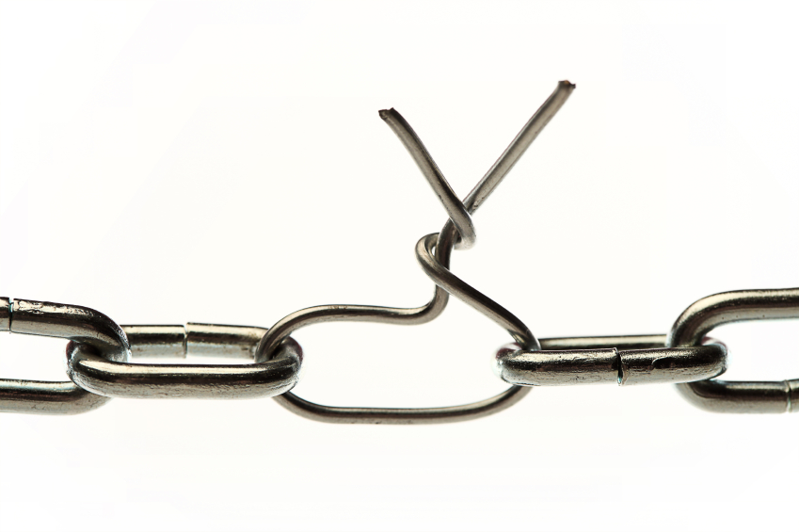
The Problem
The human is considered the weakest link
Anytime a user fails, it is considered an awareness failing
People then question the value of awareness
Nothing changes

Slide 3
The Reality
Successful attacks against users result from a systematic failure of the entire security infrastructure
Technology, Governance, and Awareness address issues in silos without coordination
Security teams seem literally afraid to do anything significant to change culture

Slide 4
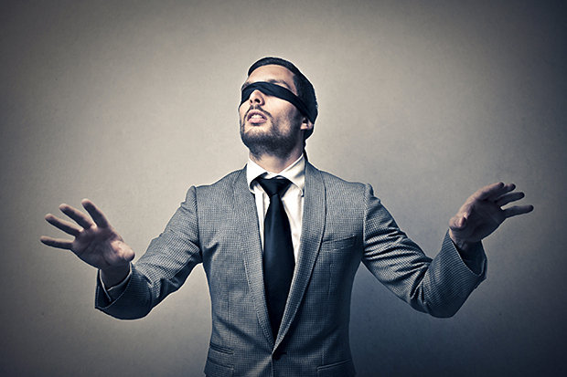
Awareness Isn’t Perfect

Slide 5
Most Awareness Programs Are Not
Frequently limited to Computer Based Training
Not practical
Even phishing simulations don’t necessarily protect you from real phishing attacks
  Frequently train people to recognize the simulations
Most awareness of other attacks is focused on specific situations

Slide 6
Even Smart People Make Mistakes
How many of you have clicked on a phishing message?
How many of you let visitors in doors, or posted too much on the Internet?
Accidents happen
Some attacks are very well crafted

Slide 7
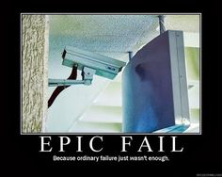
Technology Failures

Slide 8
Kill Chain
There are many phases of an attack
Each phase represents a point of protection
Each phase represents a point of failure
Each phase represents a point of detection
Each phase represents an opportunity to kill the attack in progress

Slide 9
Traditional Kill Chain
Phases of an attack
  Find
  Fix
  Track
  Target
  Engage
  Assess

Slide 10
Adversary Activity
Target identification
Force dispatch to target
Decision and order attack
Destruction of target
  Can include capture of information
  Destruction or infiltration of systems

Slide 11
The Human as a Choice Vector
The attackers target humans as one potential vector of many
Became a vector of choice
Poor awareness
Poor controls around the human
Assume the organization has already been targeted, then the determine which people to target

Slide 12
Destruction of Target
Execution of actions
Collect information
Destroy information
Ransomware
Implant listening devices

Slide 13
Each Attack has Own Kill Chain
Physical attacks use different methods and have different prevention, detection, and reaction strategies
Policies, procedures, and guidelines must be identified for Protection, Detection, and Reaction
Technology must be implemented as appropriate

Slide 14
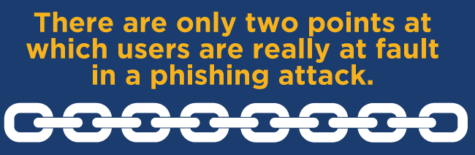
10 Phases of The Phishing Kill Chain
There are 10 opportunities to stop phishing attacks
9 within your control
7 technological
2 user related
10 phases to stop the attack

Slide 15
Later Detection Can Feed Prevention
Phishing typically launched against multiple targets simultaneously
Messages can be clicked over weeks
Early detection can remove unopened messages earlier in the kill chain than originally detected
Can look for infections not prevented
Mitigates successful attacks
Important for future mitigation

Slide 16
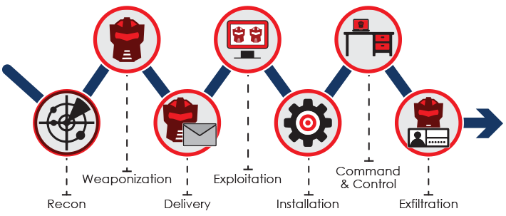
Phishing Kill Chain

Slide 17
Pre-Mail Server
Internet infrastructure should prevent phishing messages in the first place
Perimeter devices can potentially filter some illicit messages

Slide 18
Mail Server
Mail server should detect phishing messages
Suspected messages should be quarantined
Reports of phishing messages should result in unopened messages being deleted
Payloads should be removed even if forwarded to users

Slide 19
Client Mail Application
Provides another layer of filters
Quarantines suspected spam and phishing
Frequently this is two layers
  Mail application
  Client anti-malware

Slide 20
User Review
Message in the spam folder
  The user can leave it there
  The user can open it and take action
Message in inbox
  The user can perceive it as a phishing message
  The user can take action

Slide 21
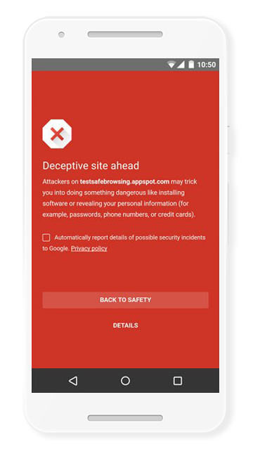
Mail Application Confirms Action
The application should warn the user against action
Ignore spam folder location
Warn of clicking on link
Warn of potential for malicious software
Other warnings as appropriate

Slide 22

User Considers Warnings
User considers if they really want to take the action
Reports spam
Deletes message

Slide 23
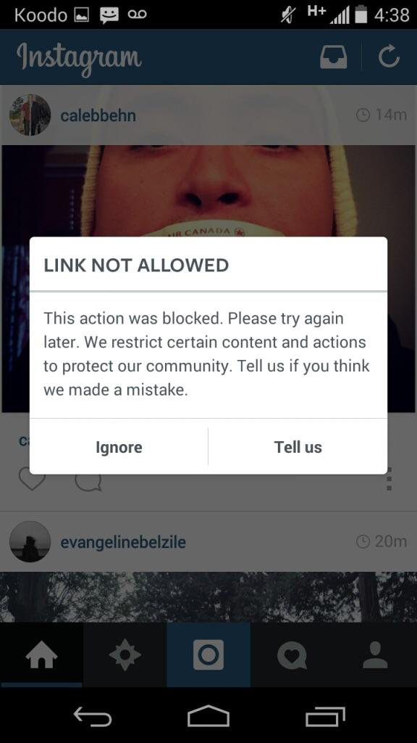
Client Prevents Attack
Outside the mail application, the system prevents infections
Stops malicious programs from loading
Stops user from going to malicious links
Warns if user attempts to send data to outside parties
DLP
Detects loading of keystroke loggers

Slide 24
Network Prevents Actions
Beyond client, network should detect impact
Sees uploading of files
Web filters prevent malicious links
Other preventative measures should stop a variety of actions

Slide 25
Network Detects Successful Attacks
Intrusion detection and prevention should detect indications of attacks
Data streams out of the network
Illicit logon attempts should be detected
There are always signs that should be found

Slide 26
Detected Compromises Should be Mitigated
Once an attack is detected, it should be stopped
Detection itself doesn’t stop attacks

Slide 27
Kill Chain Summary
Pre-mail server
Mail server
Client mail application
User
Client application warns user
User confirms action
Client prevents damage
Network prevents damage
Network detects attack
Network mitigates attack

Slide 28
Backward Mitigation
When an attack is detected, phishing allows for mitigation early in the kill chain
Not all messages are opened at the same time
  Might be opened over a week or more
  Although most might be opened within an hour
If user reports message to admins, admins can delete messages still unopened in user queues
Domains can be blocked
Malware can be detected and deleted

Slide 29
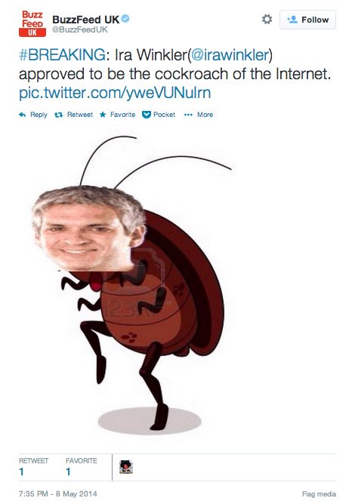
Successfully Stopping the Syrian Electronic Army
They were mad at me for calling them cockroaches at RSA 2014
  The truth hurts
They attacked RSA Conference, Wall Street Journal, and BuzzFeed
Wrote article for Computerworld
Threat intelligence defined how they would retaliate against Computerworld and parent company
Warned users
Users reported phishing messages
Unopened messages deleted and domains blocked

Slide 30
The Missing Piece…Process
Governance is generally a stack of documents
Need to determine where decisions are made
  Reduce decisions
  Define decisions
Look to technology to reduce exposure or mitigate user actions
Process implemented through technology
Process defined to users

Slide 31
The Human Security Officer
Looks at attacks targeting humans and other human related vulnerabilities
Examines attack/loss kill chain
Determine optimal ways to design process to avoid detect

Slide 32
HSO Actions
COORDINATED RESPONSE after kill chain examination
Technology
  Prevent attacks from getting to humans
  Mitigating attacks after bad user actions
Procedures/Guidelines for user decisions
  Remove decisions
  Define decisions to remove discretion
Awareness
  Promote defined behaviors
  Some general awareness

Slide 33
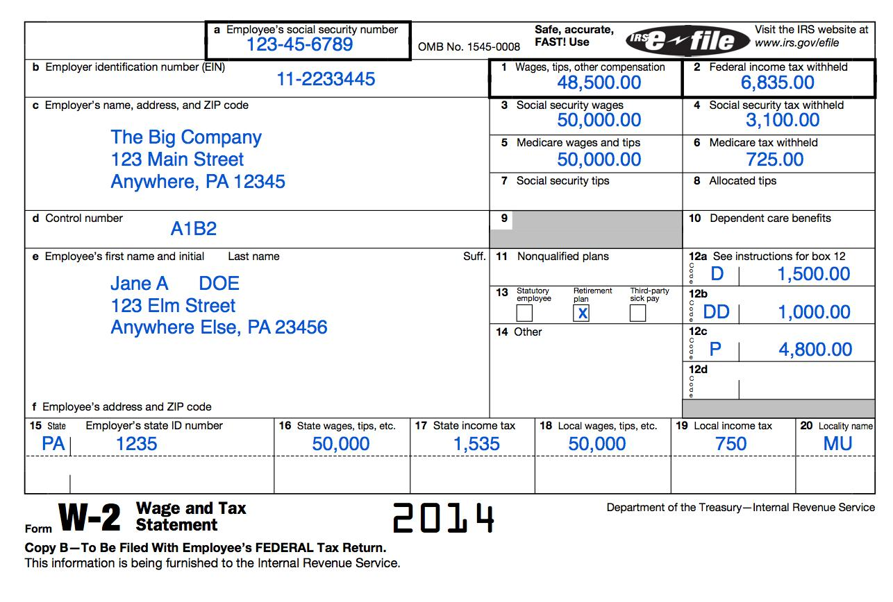
Examples
W-2 Fraud
Malware
Tailgating

Slide 34

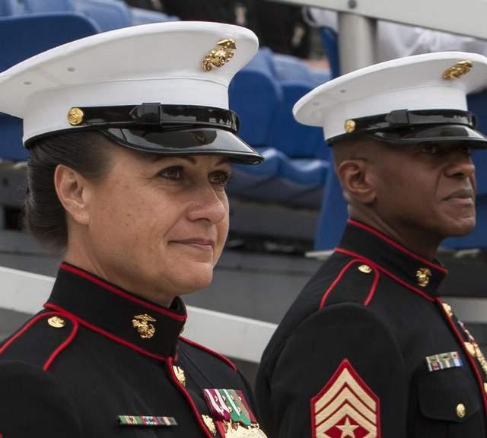
Which One Are You Creating?

Slide 35
Summary
Acknowledge user failure is not just a user failure
There needs to be specific coordination of mitigating attacks and losses involving people
There are Chief Network Architects, Chief Data Architects, etc. Why not HSOs?
It is much more than awareness

Slide 36
The Book, The Myth, The Legend

Slide 37
For More Information
www.irarireport.com
@IrariReport
ira@securementem.com
+1-443-603-0200
www.facebook.com/ira.winkler
@irawinkler
www.linkedin.com/in/irawinkler
http://www.securementem.com
@securementem

